Slide 1
Stock Price Analysis and Forecast with Machine Learning
Simarpreet Singh
02/12/2019
General Assembly
DSI-US-6

Slide 2
Types of Stock Analysis
Fundamental Analysis involves analyzing the company’s future profitability on the basis of its current business environment and financial performance.
Technical Analysis, on the other hand, includes reading the charts and using statistical figures to identify the trends in the stock market.

Slide 3
Problem Statement
In this project we will analyze data in terms of stock prices from Home Depot historical data. We will analyze and model the data to provide us with predictions. These predictions will help us in forecasting and technical analysis.

Slide 4
Data Set
The data set contains daily price of the home depot stock from September 22, 2014 till January 28, 2019
The data set contains opening price, closing price, daily high, daily low and the volume of shares.
We will consider the close price as the target variable as the profit and loss are calculated through the closing price.

Slide 5
Methodology
In this project we will deploy the following models:
Linear Regression
ARIMA - Auto Regressive Integrated Moving Average
LSTM - Long Short Term Memory
We will examine the predictions of the model through graphing the predictions
We will also utilize metrics such as MSE and RMSE to evaluate our model.

Slide 6
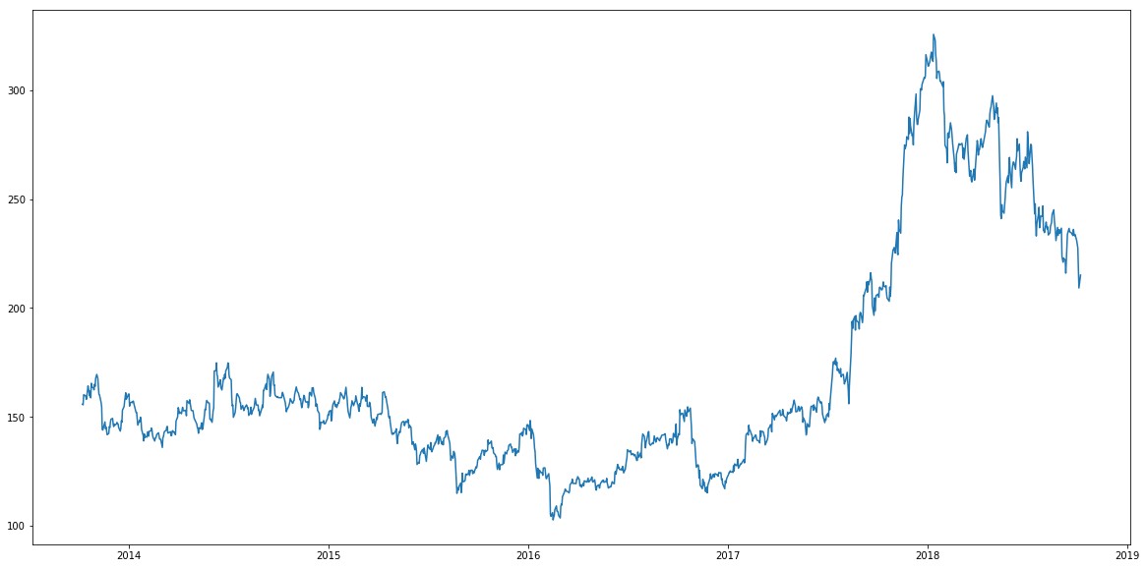
Initial Close Price Shape

Slide 7
Linear Regression
Linear regression modelling provides us with a relationship between a dependent variable and independent variable(s).
This relationship can be expressed in mathematical terms Y = a+ bX where:
Y = dependent variable
X = Independent variable
a = intercept
b = slope

Slide 8
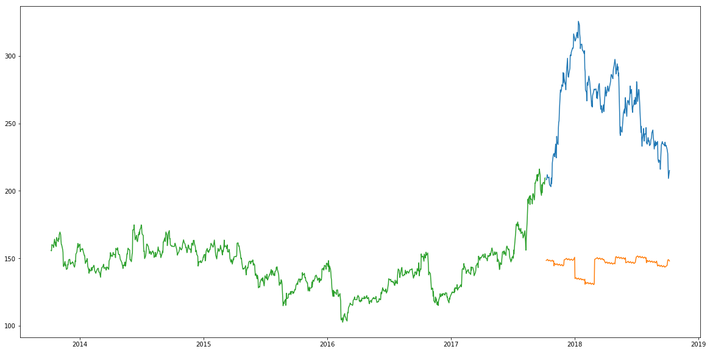
Linear Regression Predictions

Slide 9
Linear Regression Inference
RMSE - 121.162915
The simplicity of Linear Regression makes it easy to interpret.
The model overfits date and month as it takes into account exact dates a month ago or an year ago.
Linear regression is useful where independent features are much more useful such as sales prediction.

Slide 10
ARIMA
ARIMA is a very useful modelling technique for time series forecasting.
ARIMA is an abbreviation for Auto Regressive Integrated Moving Average.
ARIMA takes into account past values to predict future values.
This modelling technique has three important parameters:
p - past values that will be utilized for forecasting
q - past forecast errors used to predict future values
d - differencing order

Slide 11
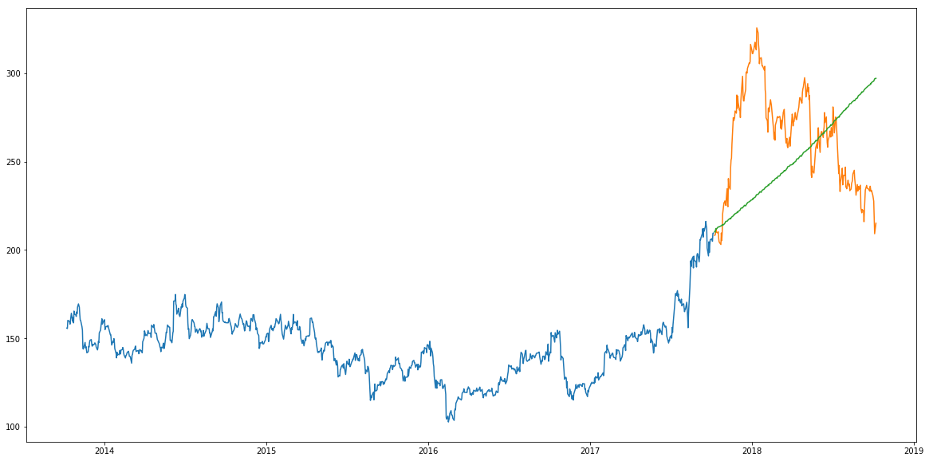
ARIMA Predictions

Slide 12
ARIMA Inference
RMSE - 44.95458499
The model used past data to capture trend in the time series.
Predictions are much more closer to the real value than Linear Regression.
ARIMA does not account for seasonality.

Slide 13
LSTM
LSTM is an abbreviation for Long Short Term Memory.
LSTM’s are widely implemented for effective sequence prediction.
LSTM’s claim to fame is its ability to store important past information.
This model has three gates:
Input gate - adds information to the cell
Forget gate - forgets information that is not important to the model
Output gate - returns important information as output

Slide 14
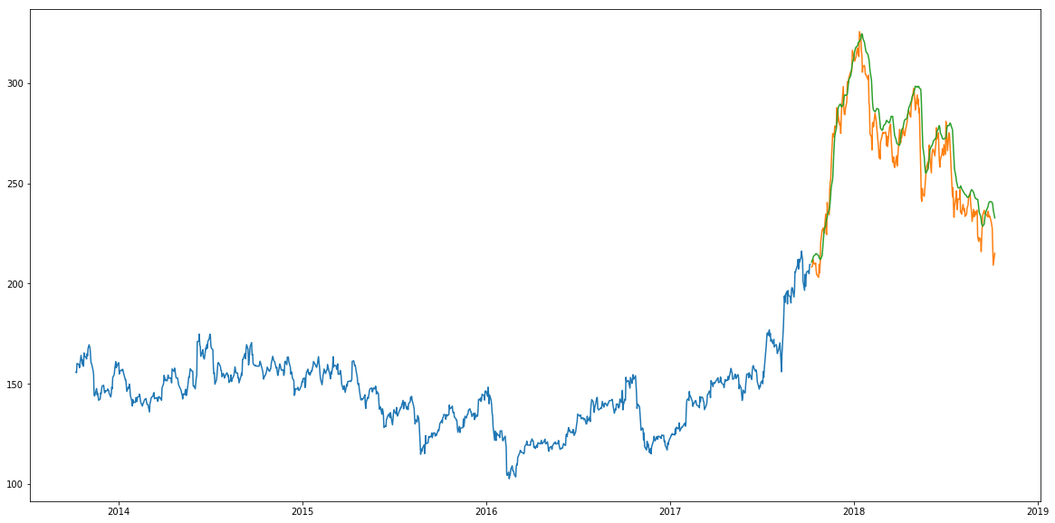
LSTM Predictions

Slide 15
LSTM Inferences
RMSE - 11.772259
LSTM in our case has been the best algorithm in terms of predictions.
LSTM captures the stock price movement with high precision
The model is capable of more tuning by manipulating number of layers or increasing the number of epochs.

Slide 16
Conclusion
Linear Regression due to its simplicity and lack of historical context is not a option for stock predictions.
ARIMA takes past information but does not account for seasonality hence, might develop long run trends that are far from real values.
LSTM’s are the best option as the they remember important information which allows for near precise weights that help us to make more accurate predictions.

